Slide 1




MS
PowerPoint
Class V
lab 18

Slide 2


What is PowerPoint?
a slide show presentation program that's part of the Microsoft office suite of tools

Slide 3
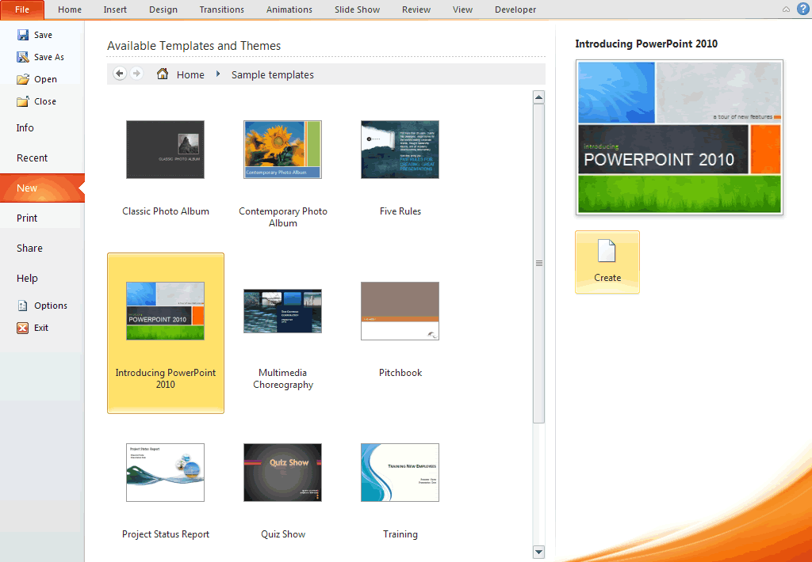
PowerPoint Template
A template defines the background, font styles, colour and sizes for your placeholders

Slide 4
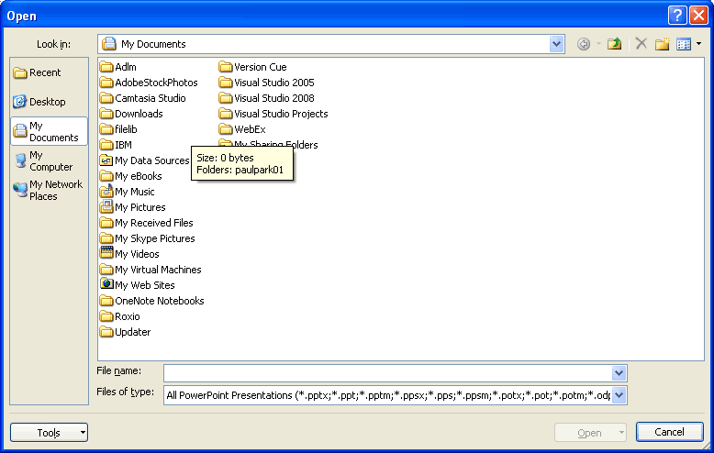
Open a File
File tab > Open. The usual Open file dialogue box that you may already be familiar with opens and you use this to locate your presentation

Slide 5
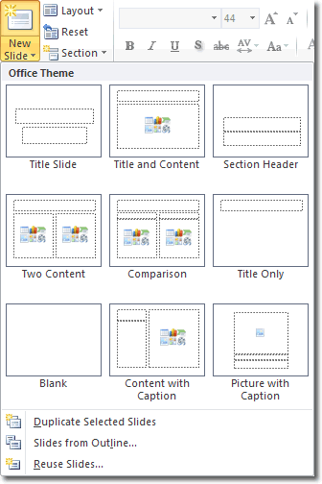
Open New Slide
Press Ctrl+m to open a new slide

Slide 6


